Slide 1
HTML5: Lesson #1

Slide 2
Agenda
Introduction to HTML
Common HTML Tags
HTML Standard and Validation
Code editors
Resources
Practice task
Homework

Slide 3
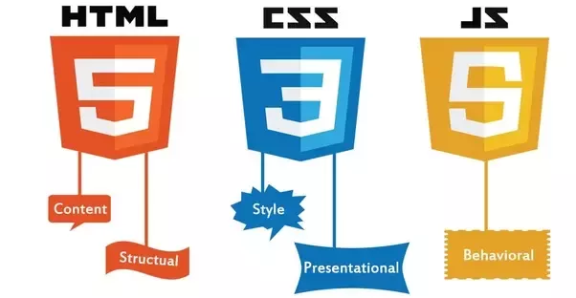
HTML / CSS / JavaScript
HTML – Hypertext Markup Language
CSS – Cascading Style Sheets
JavaScript – Scripting Programming Language

Slide 4
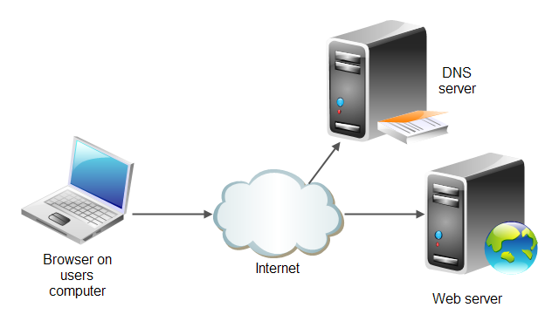

HTML Documents and HTTP Protocol
Hypertext Markup Language (HTML) is a markup language for Web pages
Hypertext Transport Protocol (HTTP/HTTPS) is a protocol that ensures transport of pages to clients
DNS
DNS, HTTP
HTTP
Notes:
Networks-lecture
www.kalin.net--->HTML with info
IP 255.543.543.994

Slide 5

HTML Document
HTML document is a text document created to represent formatted information including text, video, images, sounds
HTML document is created by tags and consists of sections
<!doctype html> <html lang="en"> <head> <meta charset="utf-8"> <title>Sample website</title> </head> <body> <p>Hello World!</p> </body> </html>
Notes:
<p>Tip: Add your own speaker notes here.</p>
@9dsadsasdfd

Slide 6
Common HTML Tags
<html>: Identifies the page as an HTML document
<head>: Contains markup and code used by the browser, such as scripts that add interactivity, and keywords to help search engines find the page
<title>: Displays the title of the Web page, which appears at the top of the Web browser, usually on the page’s tab in a tabbed browser
<body>: Surrounds content that’s visible on the Web page when viewed in a Web browser
Notes:
Tip: Add your own speaker notes here.

Slide 7
Common HTML Tags (Continued)
<p>: Defines text as a paragraph
<a href=“google.com">: Generally used to anchor a URL to text or an image; can create a named anchor within a document to allow for linking to sections of the document
<h1> - <h6>: Creates a heading, which can be first level (h1) through sixth level (h6)
<b>: Applies bold face to text
<i>: Applies italics face to text
<u>: Applies underline face to text
<img>: Inserts an image from a file or another Web site
Notes:
Tip: Add your own speaker notes here.

Slide 8
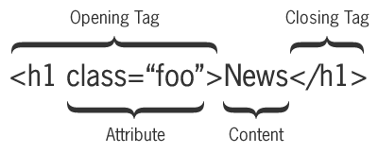
Tag Pairs
Tags are keywords that determine structure of an HTML page
Keyword is surrounded by angled brackets
Most tags come in pairs
Opening or start tag
Closing or end tag
<h1>Pet Care 101</h1>
Closing tag must have same case as opening tag
Notes:
Tip: Add your own speaker notes here.

Slide 9
Empty Tags
Empty tags don’t require an end tag
Examples:
<br> for a line break
<hr> for a horizontal line
Notes:
Tip: Add your own speaker notes here.

Slide 10
Minimal set of HTML Tags
Minimal set of tags on every Web page (note: some of them are actually optional in specs):
<!DOCTYPE> directive
<html>
<head>
<title>
<body>
<!DOCTYPE html> <html> <head> <title>...</title> </head> <body>
... </body> </html>
Notes:
Tip: Add your own speaker notes here.

Slide 11
Doctype
The DOCTYPE directive Specifies the language or rules the page uses.
In HTML, the DOCTYPE is case insensitive.
The following DOCTYPEs are all valid:
<!doctype html>
<!DOCTYPE html>
<!DOCTYPE HTML>
<!DoCtYpE hTmL>
Notes:
Tip: Add your own speaker notes here.

Slide 12
Doctype
HTML 4.01 doctype example:
HTML5 doctype example :
<!DOCTYPE html PUBLIC "-//W3C//DTD XHTML 1.1//EN" "http://www.example.com/TR/xhtml11/ DTD/xhtml11.dtd">
<!DOCTYPE html>
Notes:
Tip: Add your own speaker notes here.

Slide 13
Elements
A tag pair or an empty tag is also called an element.
An element can describe content, insert graphics or videos, and create hyperlinks.
Notes:
Tip: Add your own speaker notes here.

Slide 14
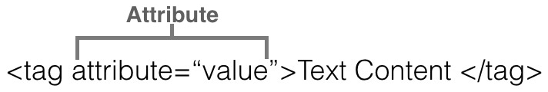
Attributes
Attributes are modifiers of HTML elements that provide additional information
Attributes are extensions of elements
Syntax:
Example:
<img src="picture.jpg" alt="Short description">
Notes:
Tip: Add your own speaker notes here.

Slide 15
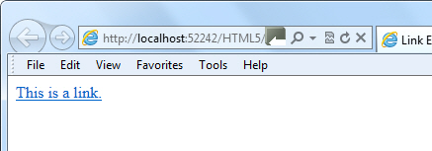
Creating a Link
Example:
<a href="http://html5.edu" target="_blank">
This is a link.
</a>
_blank: opens the linked document in a new window or tab
_self: opens the linked document in the same frame as it was clicked (this is default)
Notes:
Tip: Add your own speaker notes here.

Slide 16
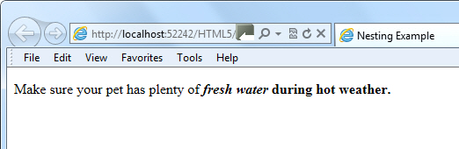
Nesting
To place one element inside another
Example:
<p>Make sure your pet has plenty of <i><b>fresh water</i> during hot weather.</p></b>
Notes:
Tip: Add your own speaker notes here.

Slide 17
Entities
A special character, such as the dollar symbol, the registered trademark (a capital R within a circle), and accented letters
Begins with an ampersand (&) and ends with a semicolon (;)
Examples:
entity &reg; represents the registered trademark symbol
Its numerical code is &#174;
https://dev.w3.org/html5/html-author/charref
Notes:
Tip: Add your own speaker notes here.

Slide 18
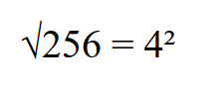
Entities (Continued)
Use UTF-8 encoding whenever possible
Add the following declaration to the <head> element:
Example:
<meta charset="UTF-8">
<p>&Sqrt;256 = 4&sup2;</p>
Notes:
Tip: Add your own speaker notes here.

Slide 19
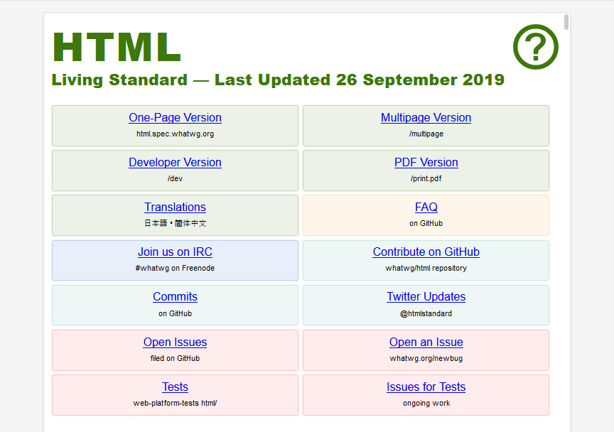
HTML Standard
https://html.spec.whatwg.org/multipage/

Slide 20
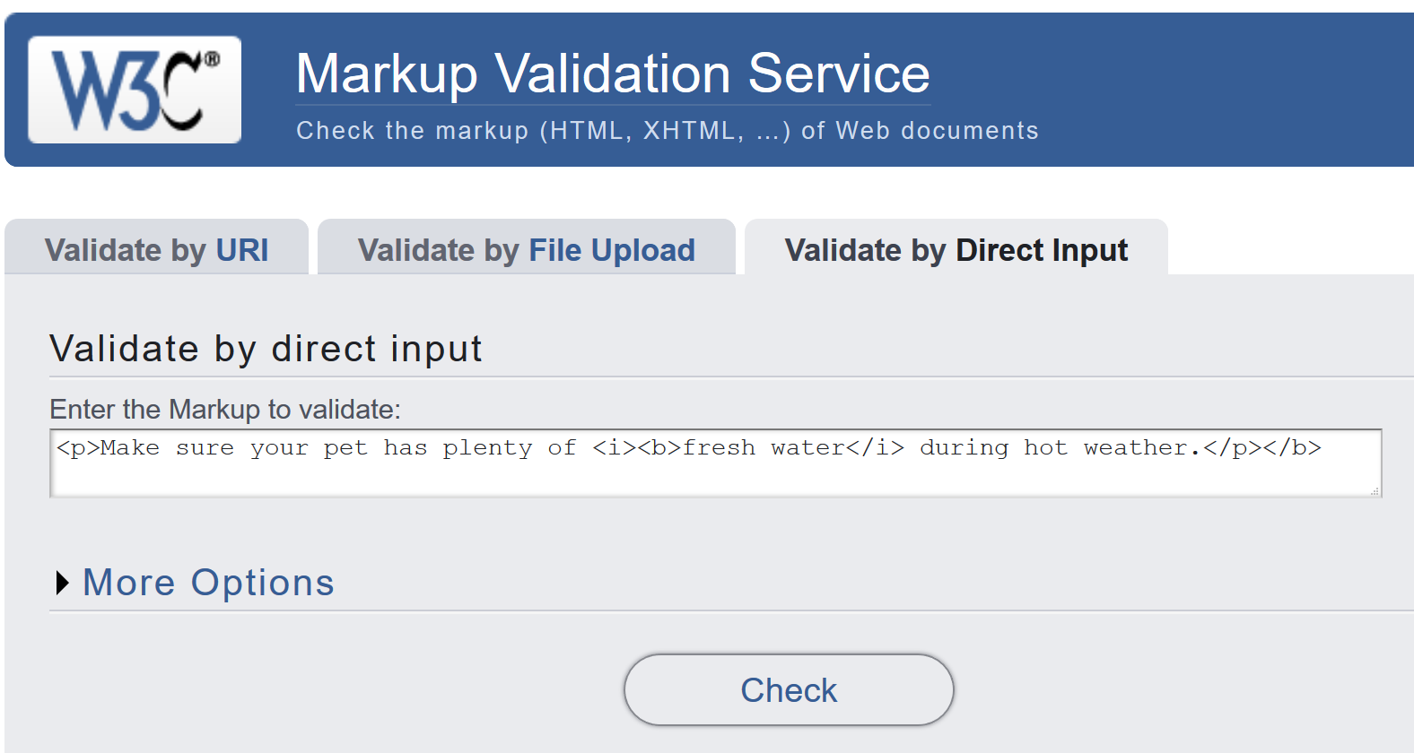
HTML Validators
HTML validator checks the markup validity of Web documents in HTML, XHTML, SMIL, MathML, etc.: http://validator.w3.org

Slide 21
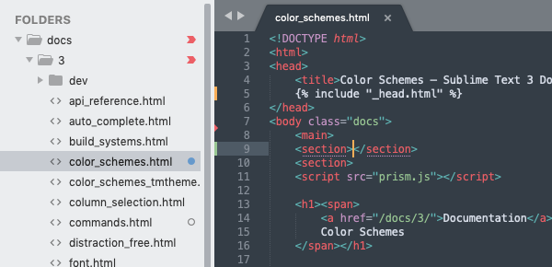
Sublime Text

Slide 22
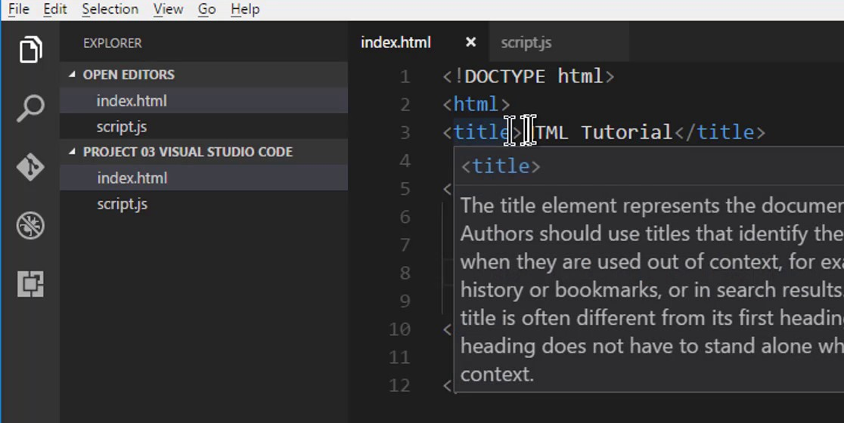
Visual Studio Code

Slide 23
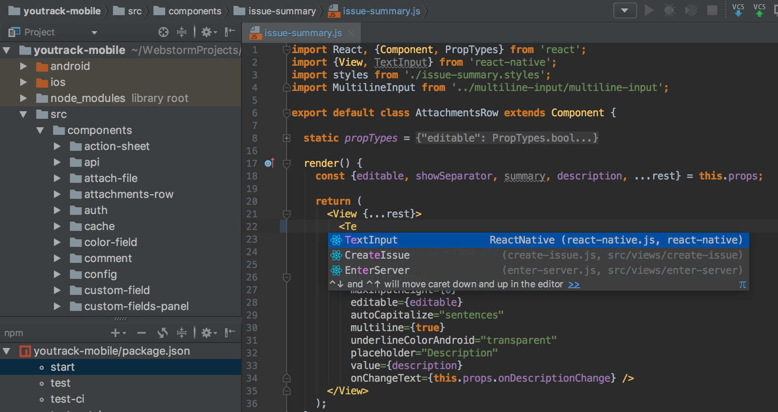
JetBrains WebStorm

Slide 24
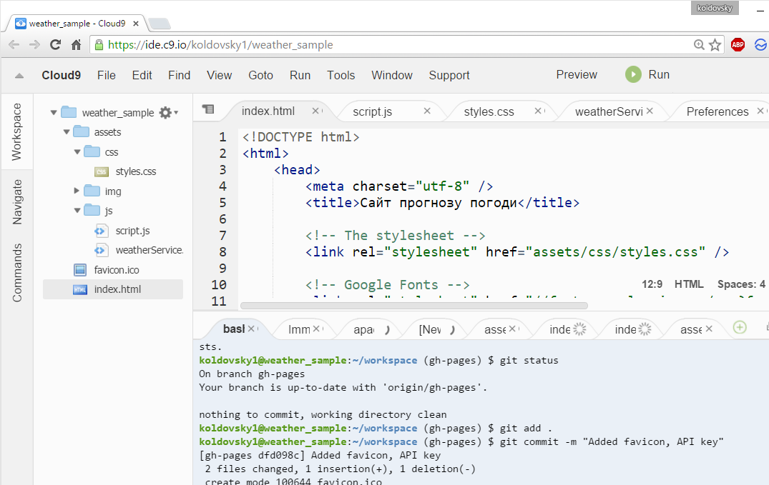
Cloud 9

Slide 25
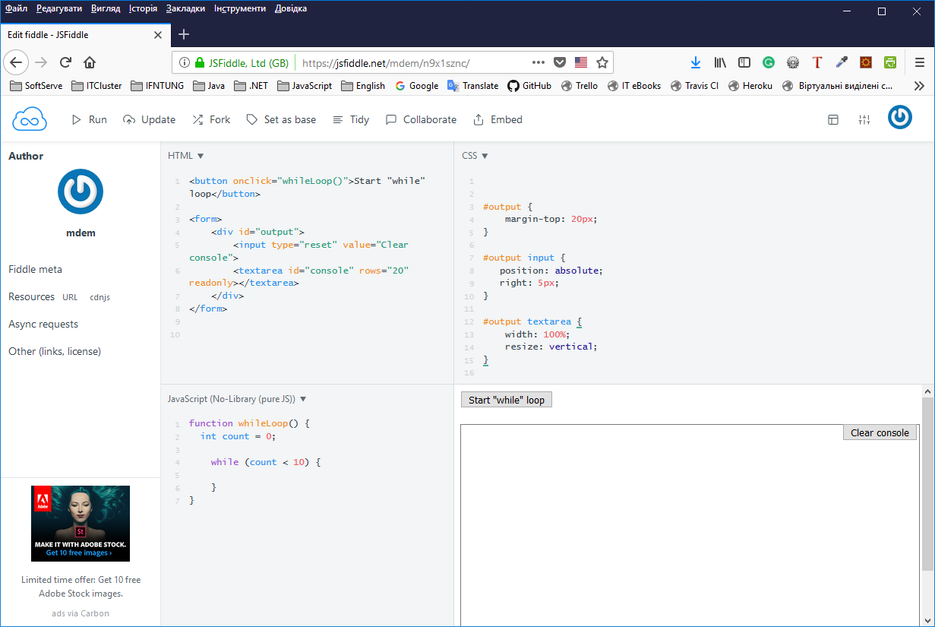
JSFiddle

Slide 26
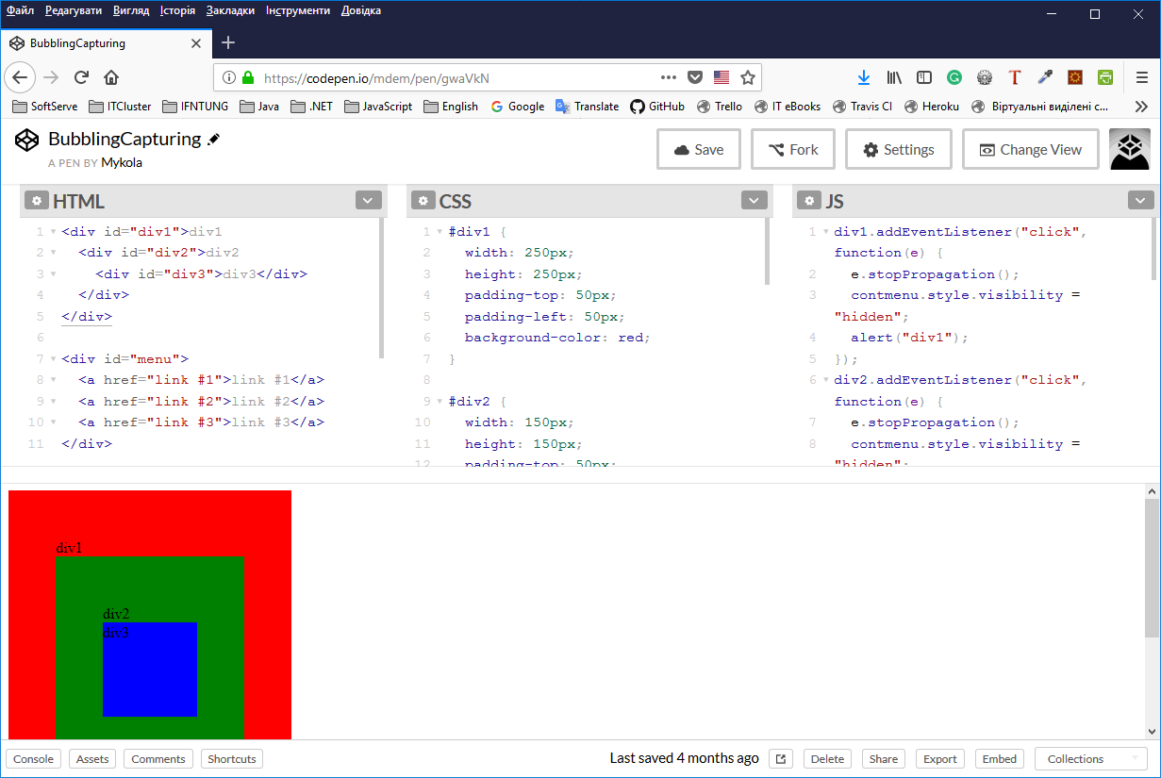
CodePen

Slide 27
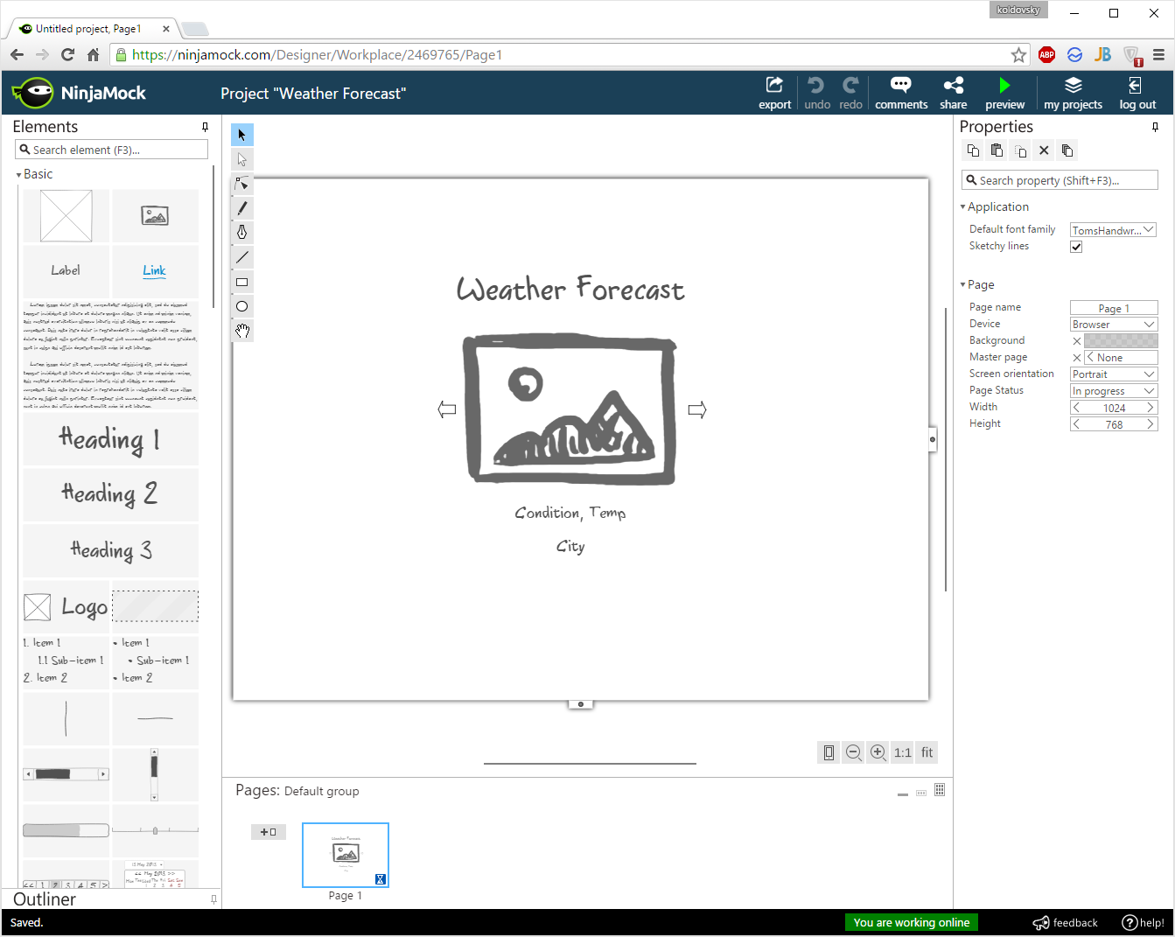
Mockups - NinjaMock

Slide 28
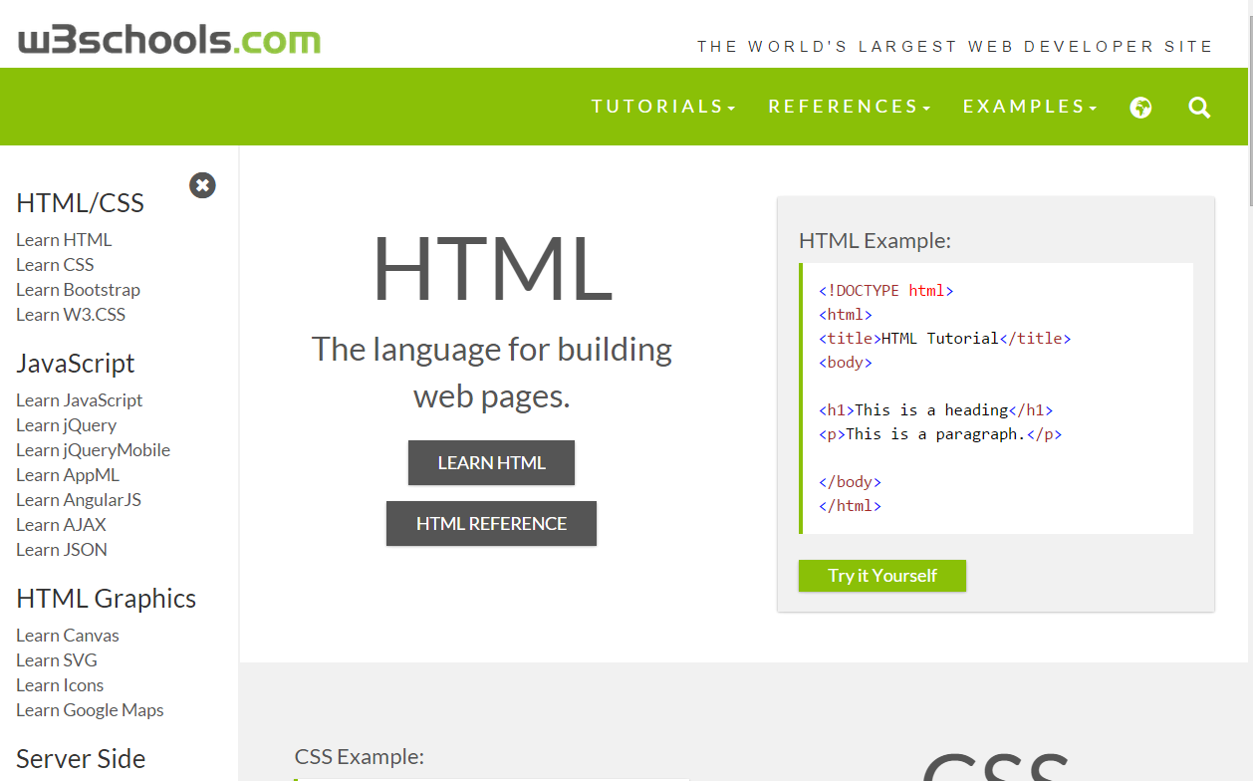
http://w3schools.com

Slide 29
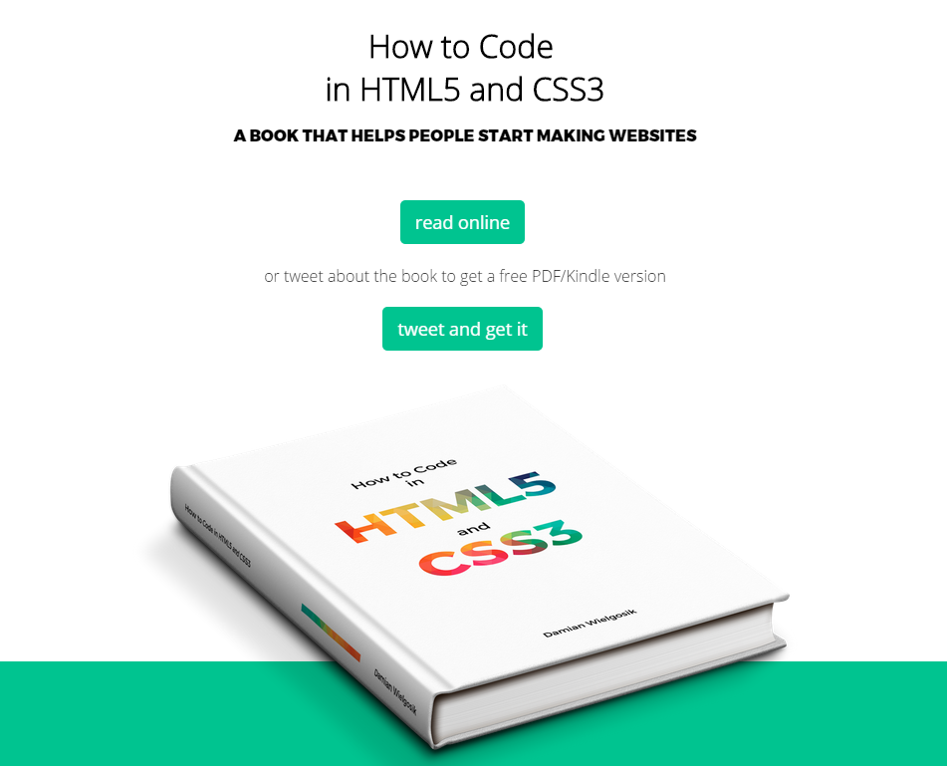
http://howtocodeinhtml.com

Slide 30
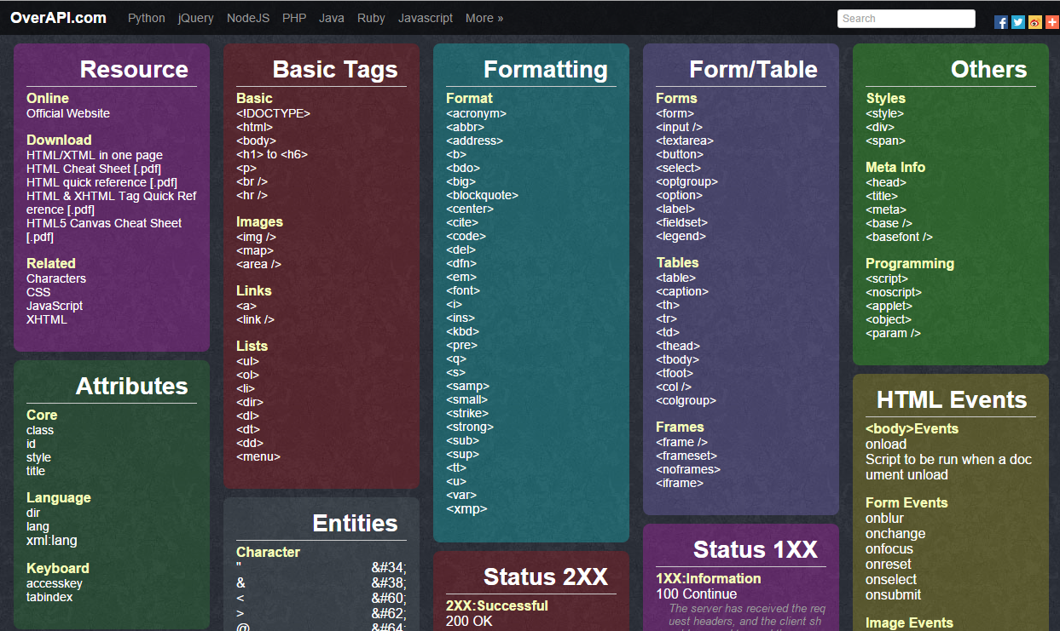
overapi.com/html

Slide 31
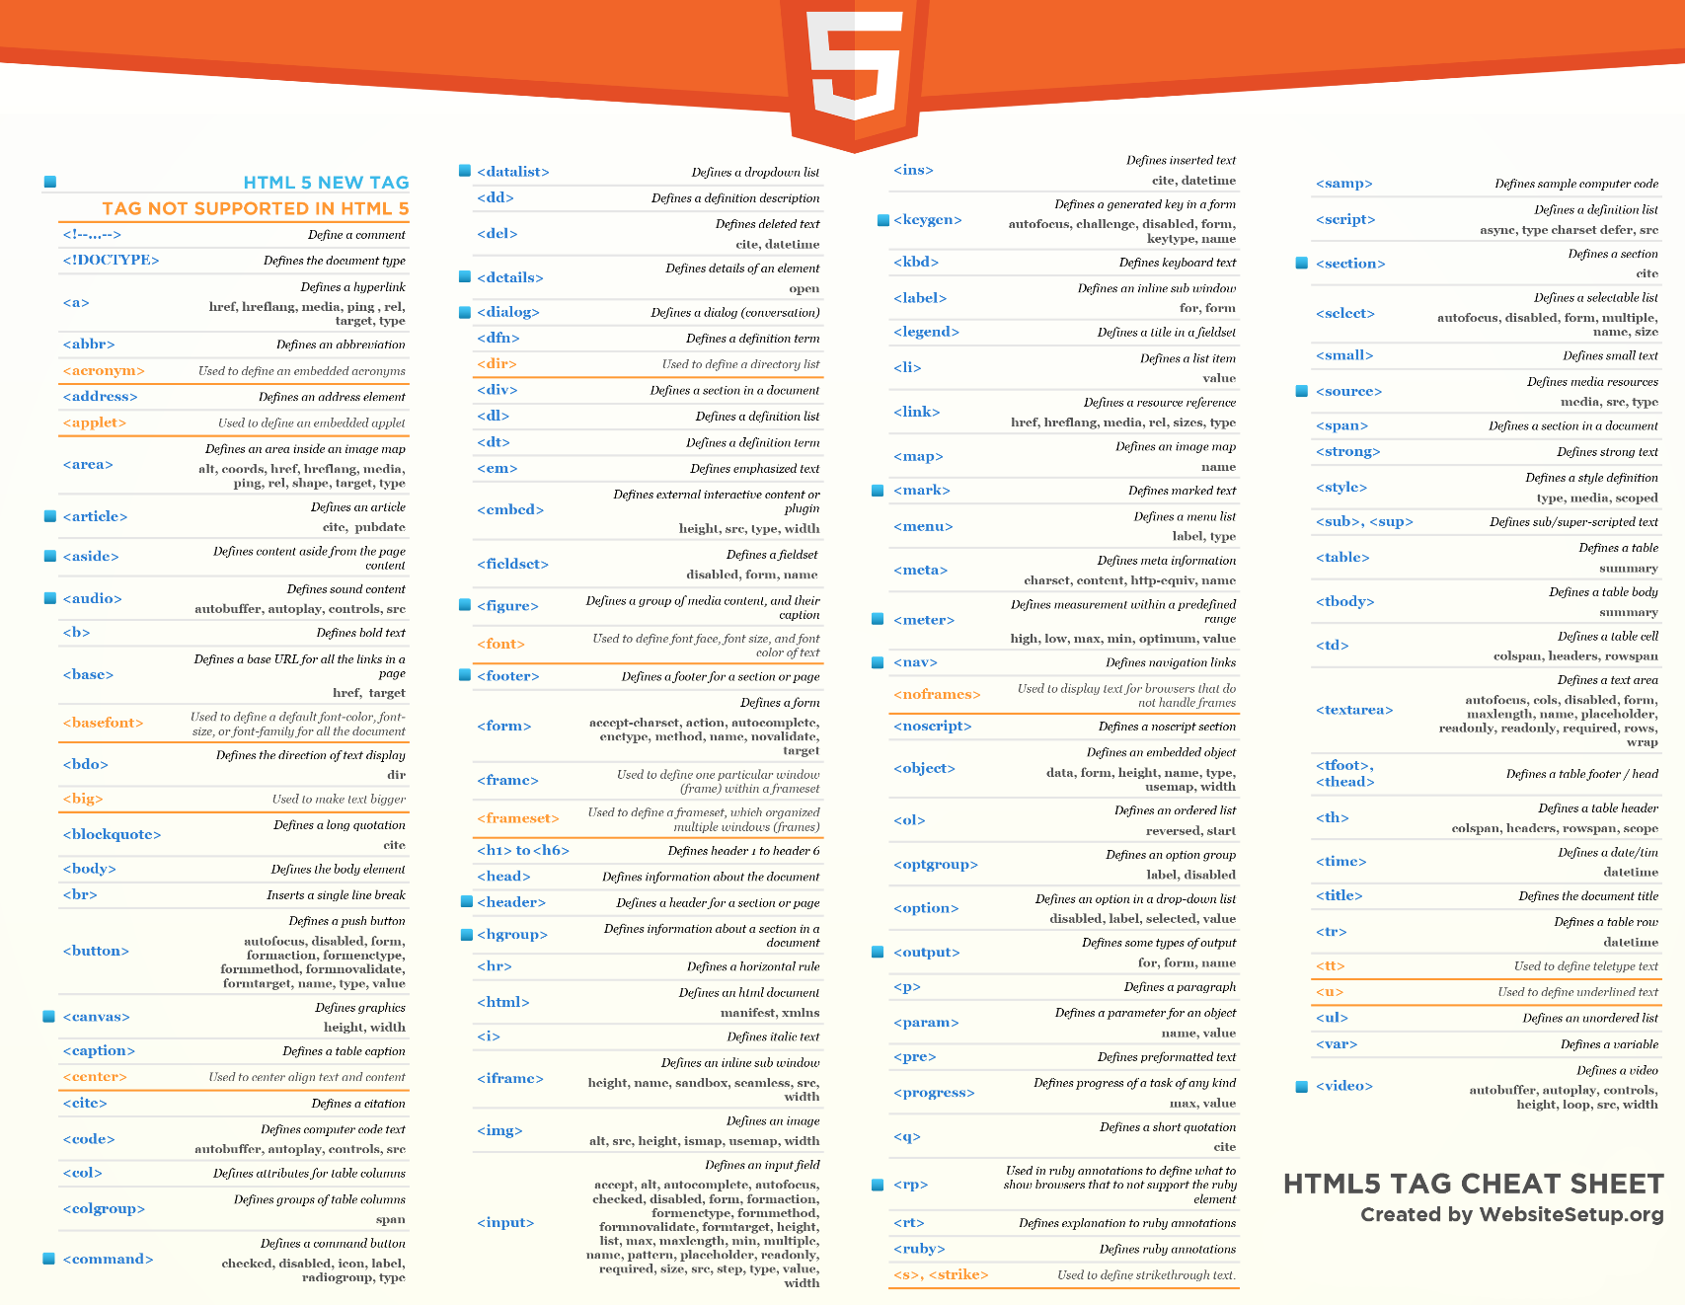
websitesetup.org/html5-cheat-sheet/

Slide 32
Contacts
Europe Headquarters
52 V. Velykoho Str.
Lviv 79053, Ukraine
Tel: +380-32-240-9090 Fax: +380-32-240-9080
E-mail: info@softserveinc.com
Website: www.softserveinc.com
US Headquarters
12800 University Drive, Suite 250 Fort Myers, FL 33907, USA
Tel: 239-690-3111 Fax: 239-690-3116
Thank You!

